Slide 1
Secure data hiding in images using steganography
CAPSTONE PROJECT
Presented By : Harsha S
Student Name : Harsha S
College Name : Jawaharlal Nehru New College Of Engineering , Shivamogga, Karnataka
Department : Computer Science And Engineering

Slide 2
OUTLINE
Problem Statement
Technology used
Wow factor
End users
Result
Conclusion
Git-hub Link
Future scope

Slide 3
Problem Statement
With growing concerns about data privacy, users need a secure, undetectable way to send sensitive information.
Classic encryption algorithms, such as AES or RSA, are identifiable and can be detected by security software.
Steganography provides a way of embedding messages into pictures without modifying their apparent attributes.
This project provides a password-protected way to hide and extract messages inside images, ensuring confidentiality and security.

Slide 4
Technology used
Programming Language:
Python (for both backend and GUI development)
Libraries Used:
OpenCV – Pixel manipulation and image processing
NumPy – Data structure handling efficiently
Tkinter – GUI development for user interface
PIL (Pillow) – Image rendering handling for preview

Slide 5
Wow factors
Seamless Message Concealment:
Hides messages within images without altering their visible appearance.
Password-Protected Extraction:
Ensures that only authorized users can retrieve hidden messages.
User-Friendly GUI:
Simple and intuitive interface for non-technical users.
Efficient Processing:
Uses optimized image flattening to embed messages without compromising quality.
Multiple File Format Support:
Works with PNG, JPEG, and JPG image formats for versatility.
Precise Extraction with End Marker
Uses a <END> marker to ensure only the hidden message is extracted, avoiding extra data.

Slide 6
End users
Journalists & Whistleblowers – Securely share sensitive information without detection.
Government & Defense Agencies – Protect classified communications from unauthorized access.
Cybersecurity Professionals – Study and enhance steganographic techniques for secure data transfer.
Corporate Organizations – Safeguard confidential business data from cyber threats.
General Public – Store and share private information discreetly.
Researchers & Ethical Hackers – Explore vulnerabilities in digital steganography and improve security measures.

Slide 7
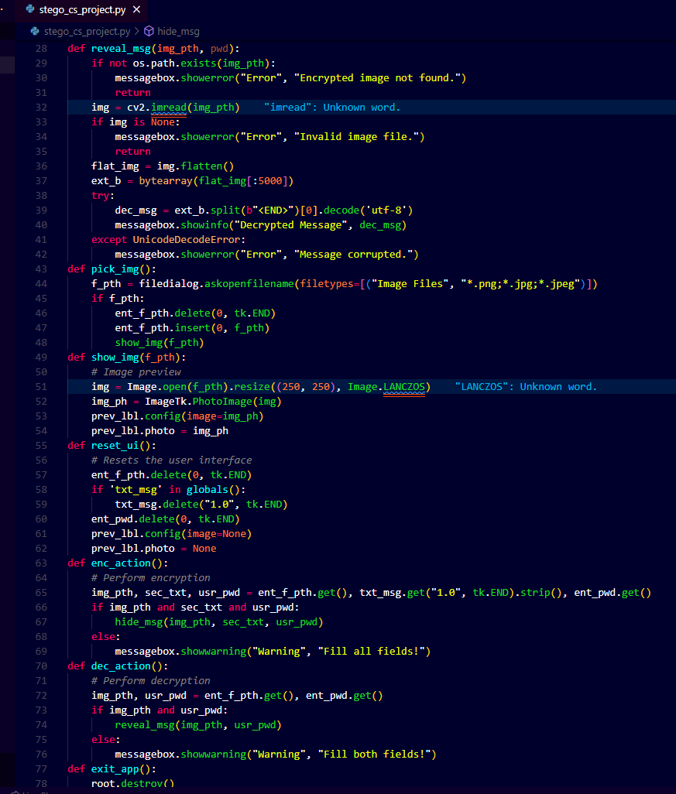
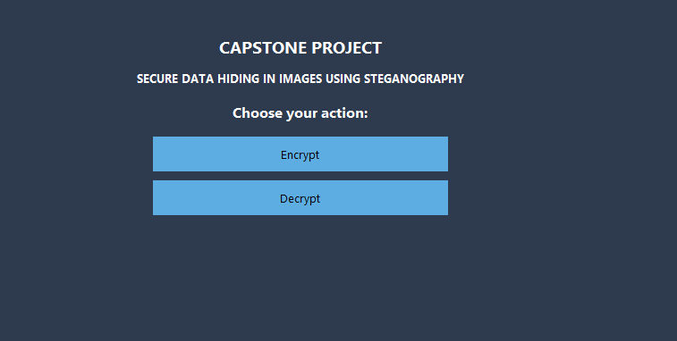
Results
Code
GUI Of The Choice Window

Slide 8
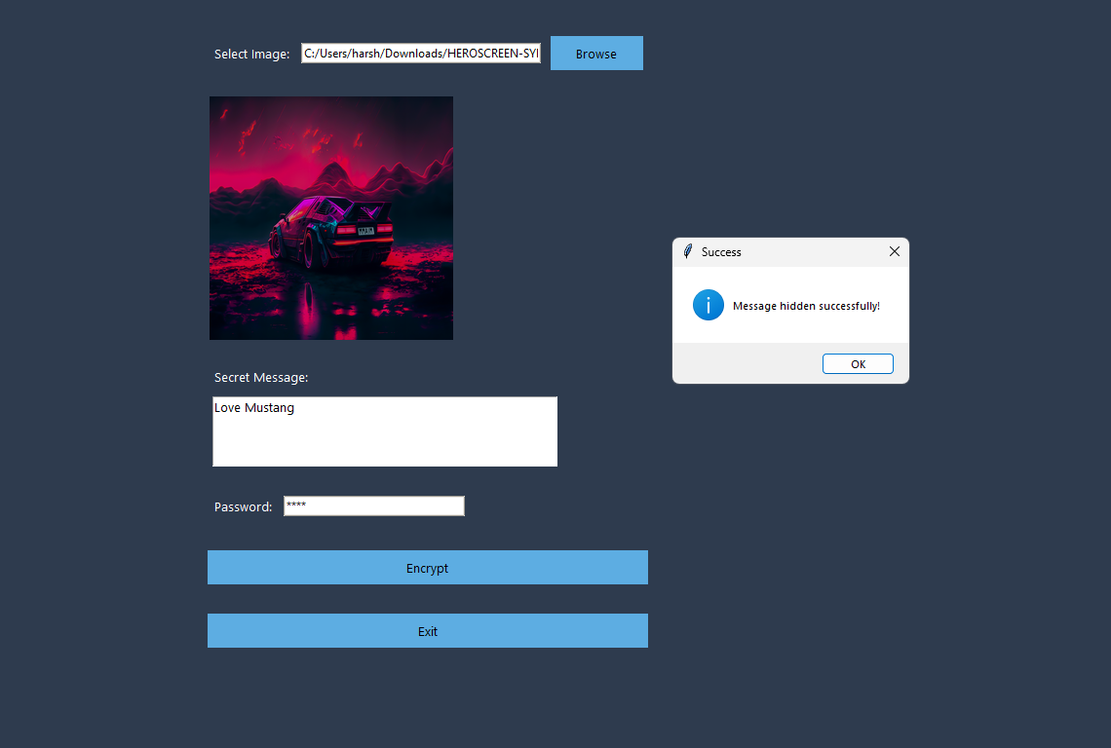
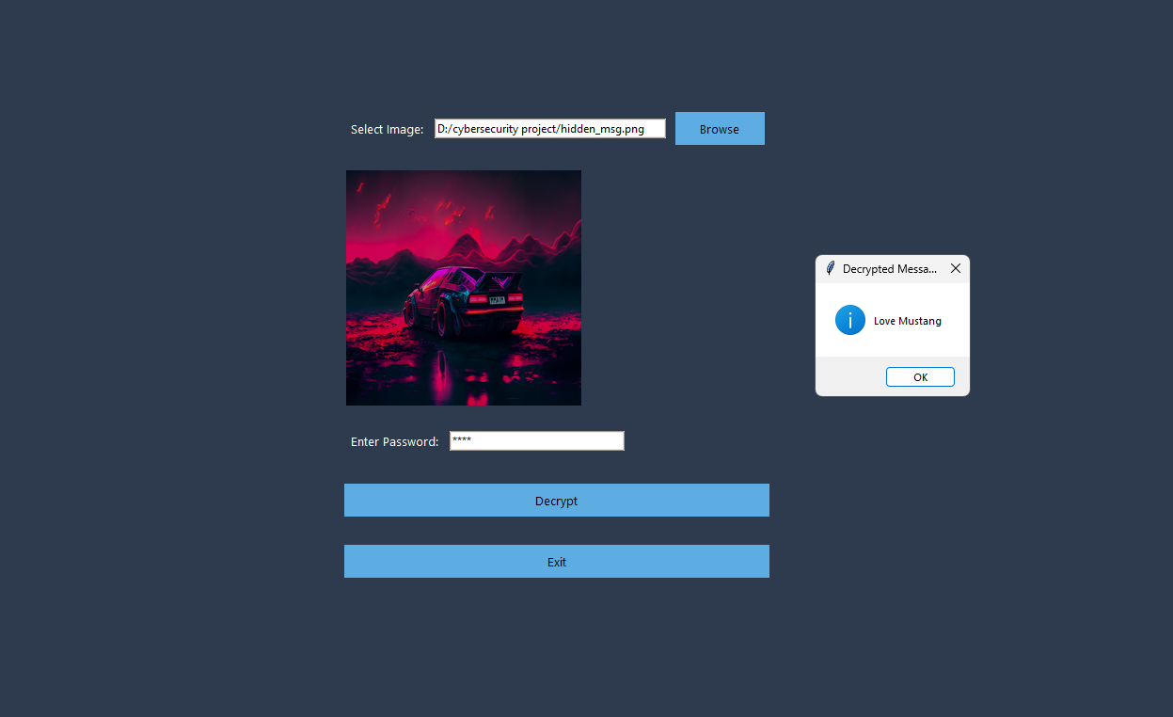
Results
GUI of the Encryption Process Window
GUI of the Decryption Process Window

Slide 9
Conclusion
Secret messages are hidden inside images without noticeable changes.
Password protection ensures only authorized users can access the hidden message.
A user-friendly interface makes the tool accessible to everyone.
Optimized with OpenCV and NumPy for fast and efficient processing.
Supports multiple image formats, including PNG, JPEG, and JPG.
Provides a secure alternative to traditional encryption methods.
Future enhancements can include advanced encryption, video steganography, and cloud integration.
quality.

Slide 10
GitHub Link
https://github.com/harshasangur48/Secure-Data-Hiding-In-Images-Using-Steganography.git

Slide 11
Future scope
Advanced Encryption: Integrate AES or RSA for stronger security.
Video Steganography: Extend functionality to hide messages in video files.
Audio Steganography: Implement techniques to conceal data in audio files.
Cross-Platform Accessibility: Develop mobile and web-based applications.
Cloud Integration: Enable secure message storage and retrieval via cloud services.
AI Detection Prevention: Use machine learning to bypass steganalysis tools.
Optimized Storage: Improve efficiency with better compression and encoding techniques.

Slide 12

THANK YOU

